Slide 1
Variables / Conditionals
18 Sept 2018

Slide 2
Previously in IMM120
Helping vs. Cheating
Coordinates
Are there more functions in p5.js?
More examples
Shapes Review
Notes:
(no pink backgrounds) sorry Charlotte

Slide 3
Previously in IMM120
Helping vs. Cheating
Coordinates
Are there more functions in p5.js?
More examples
Shapes Review
Notes:
(pictures of kittens)

Slide 4
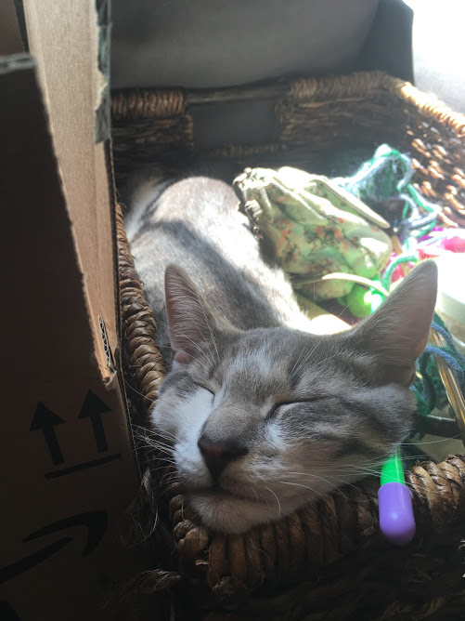
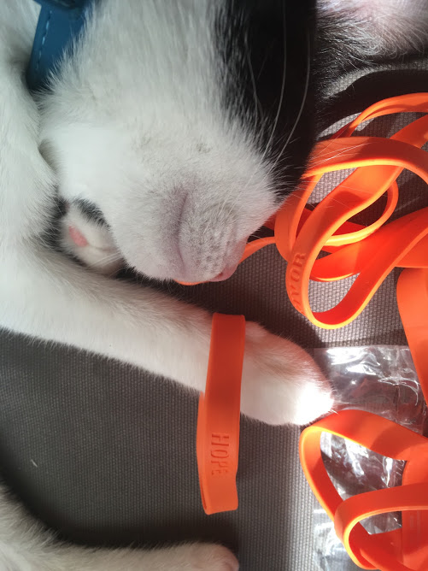
Previously in IMM120
Helping vs. Cheating
Coordinates
Are there more functions in p5.js?
More examples
Shapes Review
Notes:
(video game references)- Collision detection
coordinates
- translate(width/2, height/2)
- print(coords)
are there more functions in p5.js
more examples
- Daniel Shiffman
- https://p5js.org/learn/color.html
shapes
- rectangle anchor
- shapes with motion for clarity

Slide 5

Previously in IMM120
Helping vs. Cheating
Coordinates
Are there more functions in p5.js?
More examples
Shapes Review
Notes:
Now that all our moral support is here

Slide 6
Previously in IMM120
Helping vs. Cheating
Coordinates
Are there more functions in p5.js?
More examples
Shapes Review
Notes:
helping vs. cheating
- Using a tool versus adapting a project
- Collision detection
coordinates
- translate(width/2, height/2)
- print(coords)
are there more functions in p5.js
more examples
- Daniel Shiffman
- https://p5js.org/learn/color.html
shapes
- rectangle anchor
- shapes with motion for clarity

Slide 7
Previously in IMM120
Helping vs. Cheating
Coordinates
Are there more functions in p5.js?
More examples
Shapes Review
Notes:
coordinates
- translate(width/2, height/2)
- print(coords)
are there more functions in p5.js
more examples
- Daniel Shiffman
- https://p5js.org/learn/color.html
shapes
- rectangle anchor
- shapes with motion for clarity

Slide 8
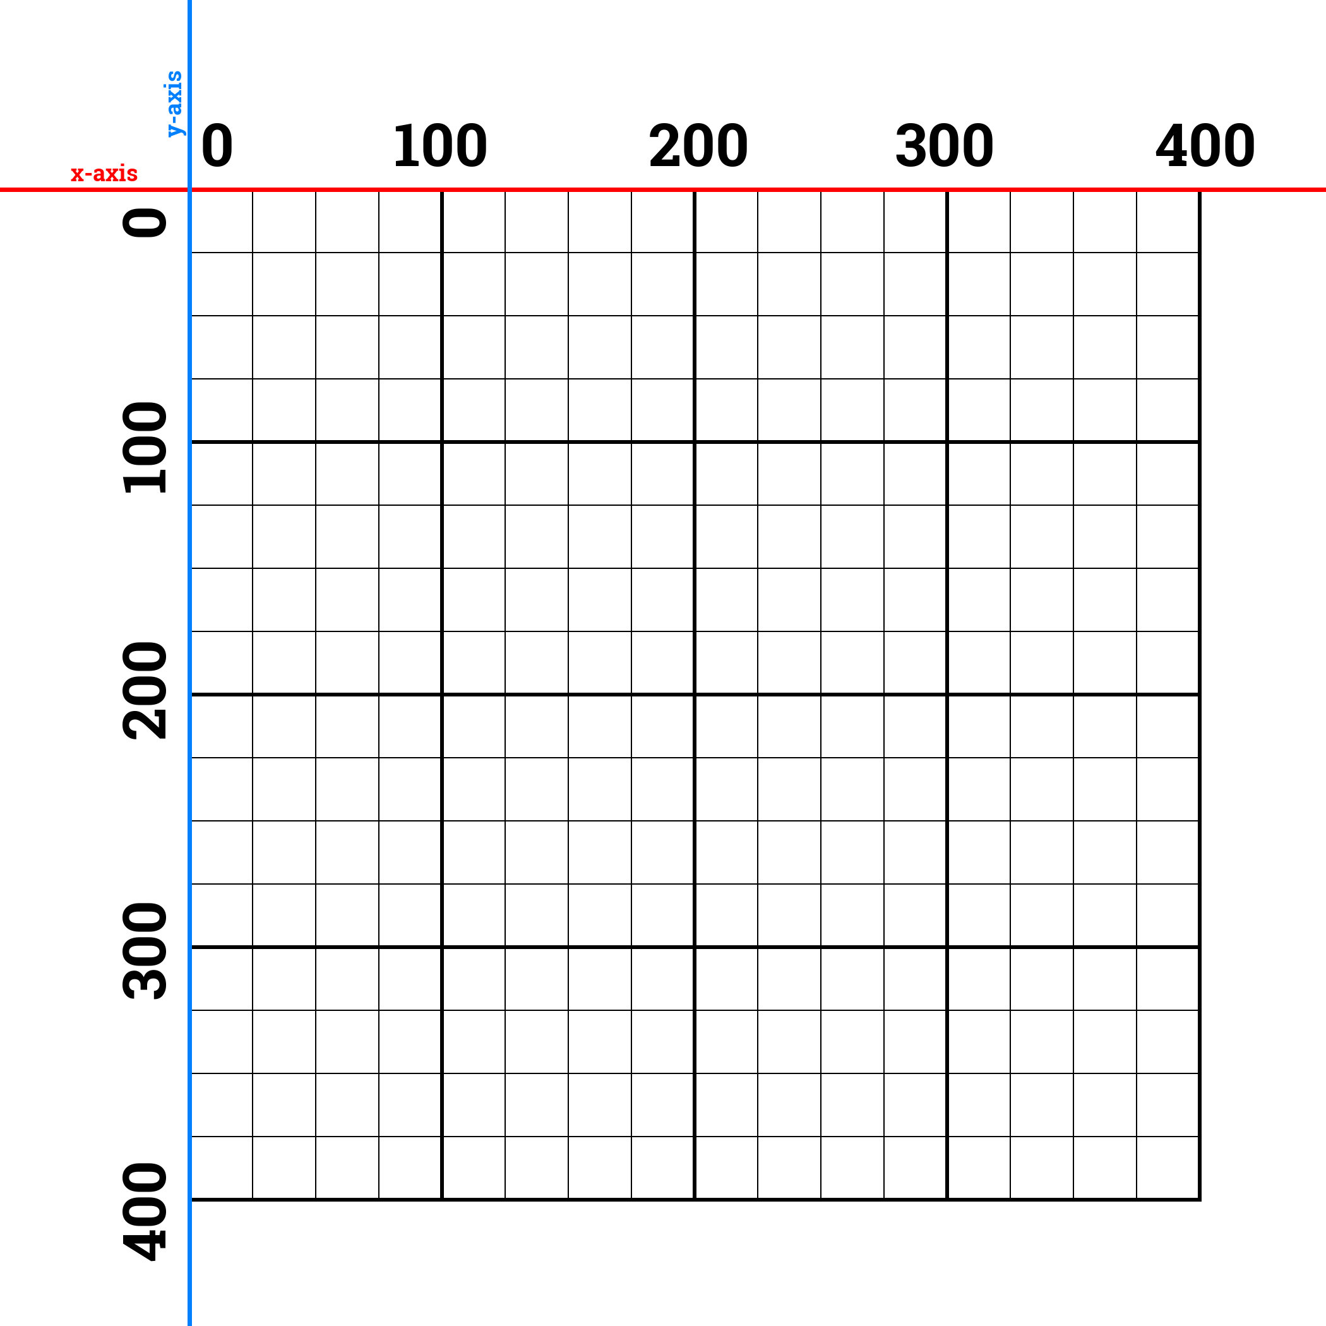

Slide 9
Previously in IMM120
Helping vs. Cheating
Coordinates
Are there more functions in p5.js?
More examples
Shapes Review
translate(width/2, height/2);
print(mouseX, mouseY);
Notes:
coordinates
- translate(width/2, height/2)
- print(coords)
are there more functions in p5.js
more examples
- Daniel Shiffman
- https://p5js.org/learn/color.html
shapes
- rectangle anchor
- shapes with motion for clarity

Slide 10
Previously in IMM120
Helping vs. Cheating
Coordinates
Are there more functions in p5.js?
More examples
Shapes Review
Notes:
more examples
- Daniel Shiffman
- https://p5js.org/learn/color.html
shapes
- rectangle anchor
- shapes with motion for clarity

Slide 11
Previously in IMM120
Helping vs. Cheating
Coordinates
Are there more functions in p5.js?
More examples
Shapes Review
Notes:
more examples
- https://p5js.org/learn/color.html
- Daniel Shiffman
shapes
- rectangle anchor
- shapes with motion for clarity

Slide 12
Previously in IMM120
Helping vs. Cheating
Coordinates
Are there more functions in p5.js?
More examples
Shapes Review
Notes:
Shapes
rectangle anchor
(commands)
- shapes with motion for clarity

Slide 13
ellipse(100, 200, 300, 400);
This line is called a command.
ellipse is a function.
by using this function, we are calling it and sending it data (arguments).
Notes:
Make a function to demonstrate

Slide 14
Previously in IMM120
Helping vs. Cheating
Coordinates
Are there more functions in p5.js?
More examples
Shapes Review
Notes:
Shapes
rectangle anchor
(commands)
- shapes with motion for clarity

Slide 15
Variables
A variable is a value that we can change with code
The value of 7 is always going to be 7
A variable labels or refers to a value and we use that reference to use that value and can assign new values to that label
mouseX

Slide 16
How Do I Make a Variable?
var cookies = 0;
var bakery = “Voodoo Donuts”;
var isDelicious = true;
Names must follow simple rules:
Can’t start with a number
No punctuation or spaces
Must be a unique name (function, mouseX, ellipse)
Tip: useCamelCase. camelCaseCapitalizesEachWordForReadability
Tip: Be descriptive. You know that pOX means “playing on Xbox” today…

Slide 17
What Can I Save in a Variable?
Numbers: 0, -5, 6, 3.141592, etc.
Strings (words): “word”, “letter”, “s”, “a full sentence.”
Booleans: true, false
Other Variables: mouseX + mouseY - width

Slide 18
Built-In Variables We’ll be Using Today
mouseX (number) – x position of the mouse
mouseY (number) – y position of the mouse
keyIsPressed (boolean) – true when any key is…
mouseIsPressed (boolean) – true when the mouse is…
frameCount (number) – number of times draw() has run since the sketch started
Notes:
Which way is which?
There is a page on Canvas that has all of the commands covered. Also p5.js reference.

Slide 19
Three Ways to Display Words:
print(variable) – Print value to the console
text(“a”, x, y) – Display words on the canvas
alert(5) – Pop-up with information, pause code

Slide 20
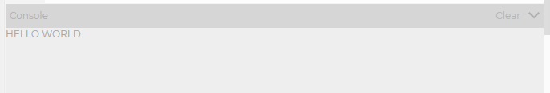
Three Ways to Display Words:
print(variable) – Print value to the console
text(“a”, x, y) – Display words on the canvas
alert(5) – Pop-up with information, pause code

Slide 21
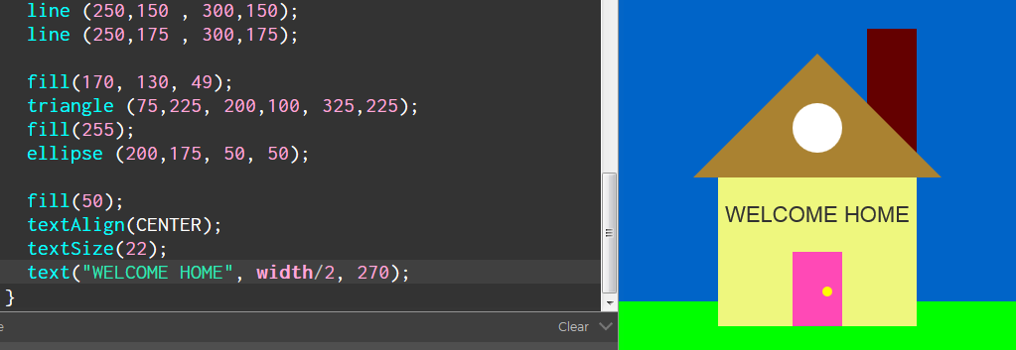
Three Ways to Display Words:
print(variable) – Print value to the console
text(“a”, x, y) – Display words on the canvas
alert(5) – Pop-up with information, pause code

Slide 22
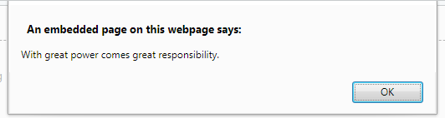
Three Ways to Display Words:
print(variable) – Print value to the console
text(“a”, x, y) – Display words on the canvas
alert(5) – Pop-up with information, pause code

Slide 23
Making a Clicker Game
Let’s break this down
Write down what shapes we need to draw
What numbers do we need to save?

Slide 24
Making a Clicker Game
Going to need some numbers
Goods, accumulative; price, rate; multiplier
Only when clicking
Conditionals
Buying Boosts
keyIsPressed
Clicking on the button
Maybe next week, we’ll see about time
Notes:
Goods, rate, multiplier, price, accumulative
Pixels = pixels + rate * multiplier

Slide 25
Is That A Bomb????
Please go to bombmanual.com. Trust me. It’s fine.
Page 5.
Shout out to Keep Talking And Nobody Explodes
Notes:
https://crhallberg.com/justwires

Slide 26
4. Conditionals

Slide 27
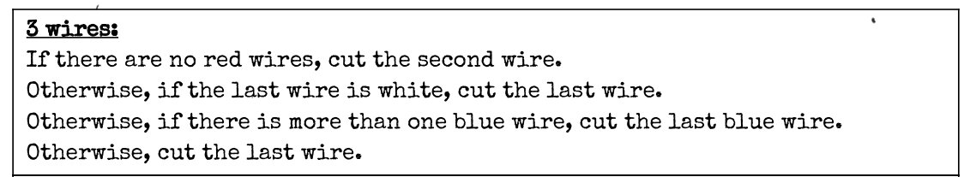
Conditionals In English

Slide 28
Conditionals In English
"If you see a bear, run!"
"If you're going to be late, give me a call."

Slide 29
The Truth
Computers can only deal with true and false (binary).
When we ask questions of computer they must be true or false questions.
The way we will guarantee that our questions are always true or false is by using comparisons for all of them.

Slide 30
Comparisons
There are four basic comparisons:
Greater than
Less than
Equal to
Not equal to

Slide 31
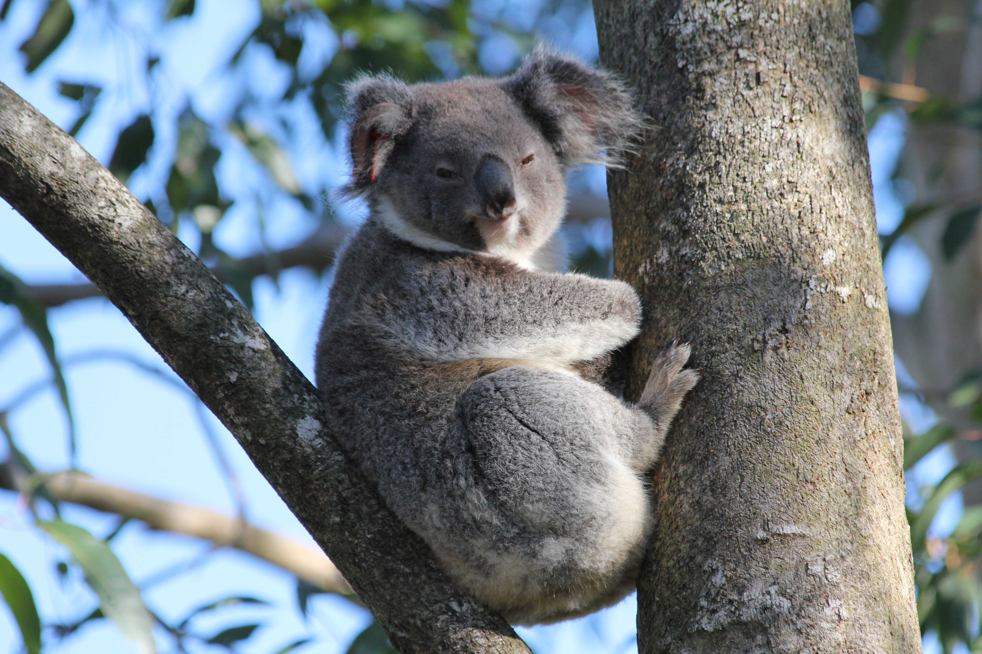
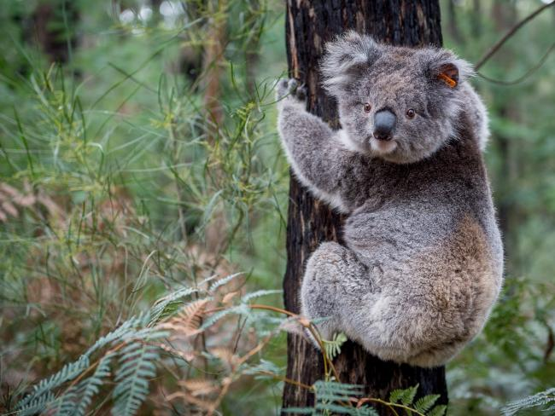
Comparison Koalas (Greater Than)
>

Slide 32
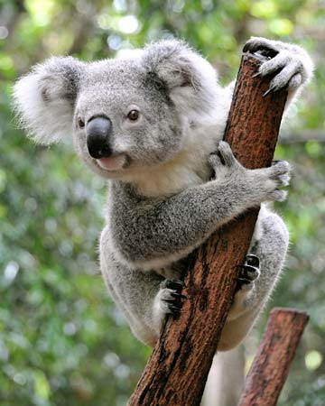
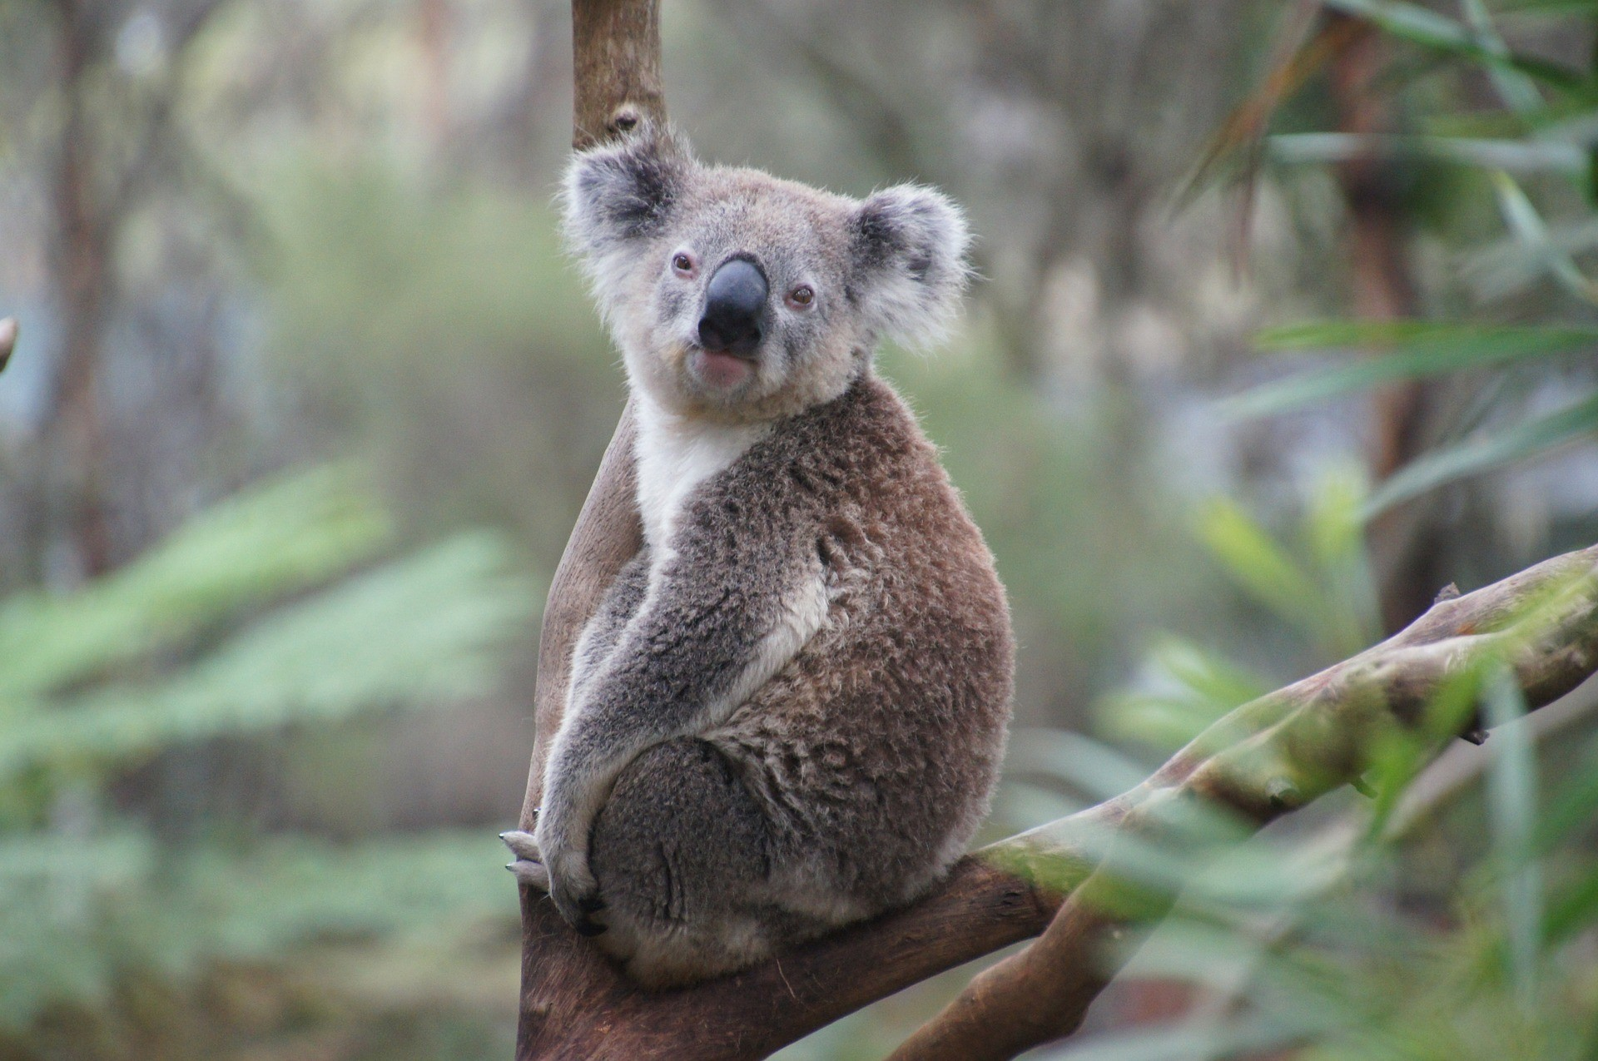
Comparison Koalas (Less Than)
<

Slide 33
Comparison Koalas (Equal To)
==

Slide 34
Comparison Koalas (Not Equal To)
!=

Slide 35
Boolean Operators
< | Less than | True: 4 < 5 False: 100 < 0
> | Greater than | True: 15 > 7 False: -1 > 1
== | Equal to | True: 4 == 4 False: 4 == 3
!= | Not equal to | True: 3.14 != 3 False: 1 != 1
!() | Not operator | True: !(False) False: !(True)

Slide 36
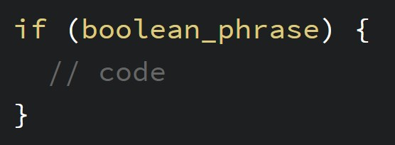
Conditionals in Code
if
code between { }
rest of sketch

Slide 37
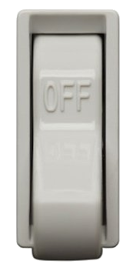
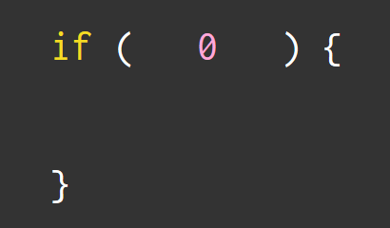

Conditionals
if
code between { }
rest of sketch

Slide 38
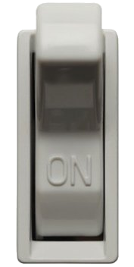

Conditionals
if
code between { }
rest of sketch

Slide 39
if (true) {
} else {
}

Slide 40
if (false) {
} else {
}

Slide 41
Shape Detection
https://crhallberg.com/CollisionDetection/Website

Slide 42
Making Things Move

Slide 43
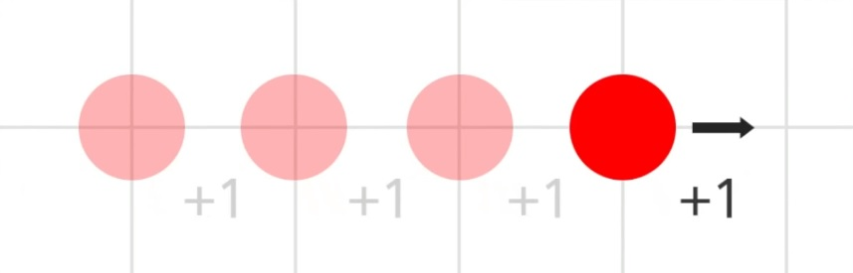

Slide 44
Minute Surveys
Once you hand in your survey, you may go.
If you have questions or concerns, I will stay and answer them for as long as I can.
Notes:
Pink backgrounds - Charlotte

